Slide 1
Forest Cover Type Prediction

Slide 2
Presented by:
Group 26
Sandy adel latef beshay 300389917
Phoebe Thabit Wadea Fana 300389915
Muhammad Mohsen Muhammad Gamal Ali 300389890

Slide 3
Problem overview
The problem requires to predict forest cover types in the Roosevelt National Forest, Colorado. The objective is to create accurate predictive models that help understand the predominant tree cover type.

Slide 4
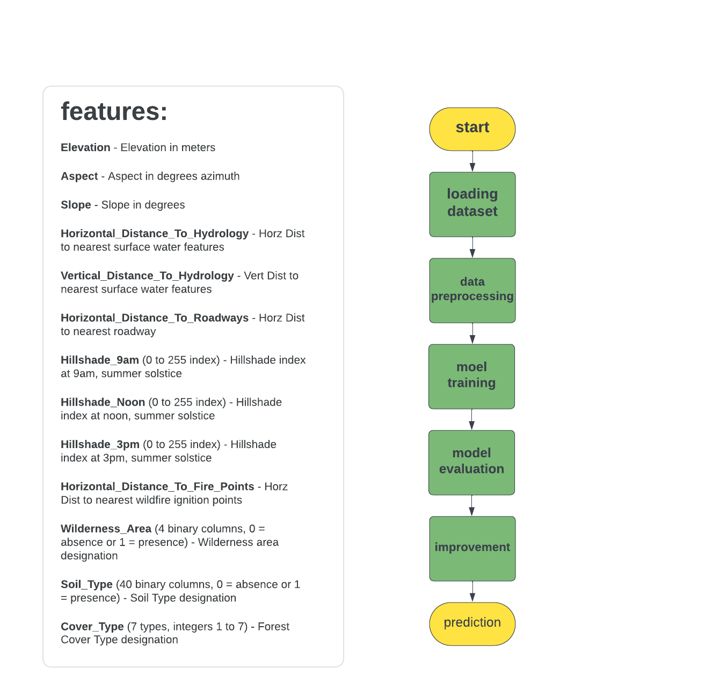
DataFlow

Slide 5
EDA

Slide 6
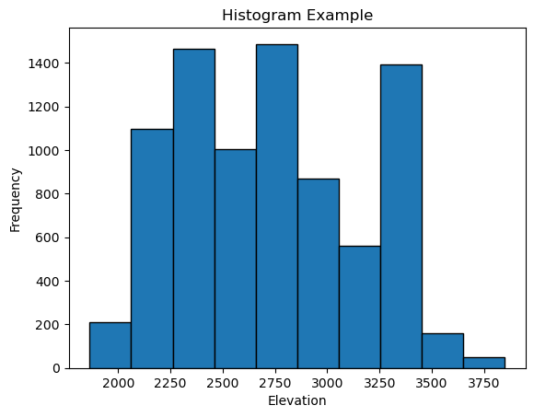
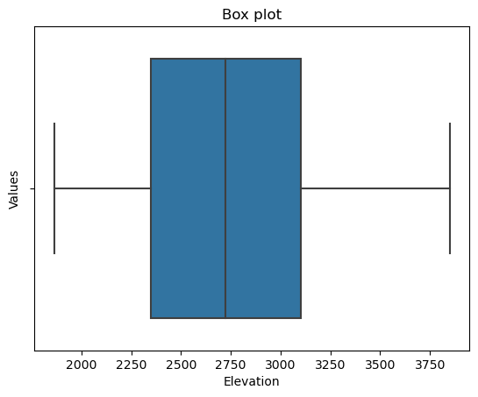
Example of feature histogram and box plot

Slide 7
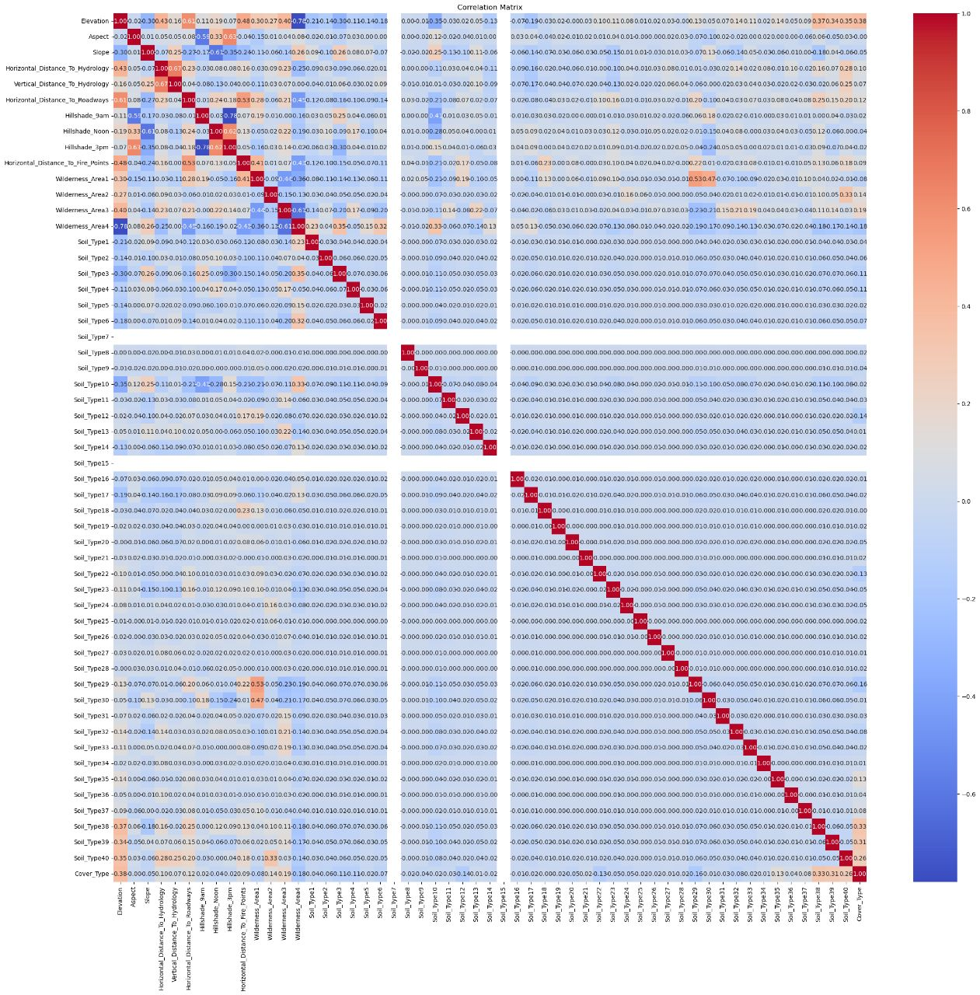
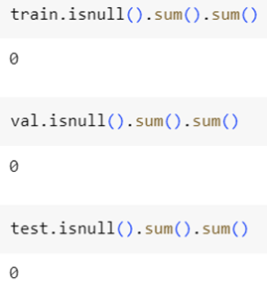

Slide 8
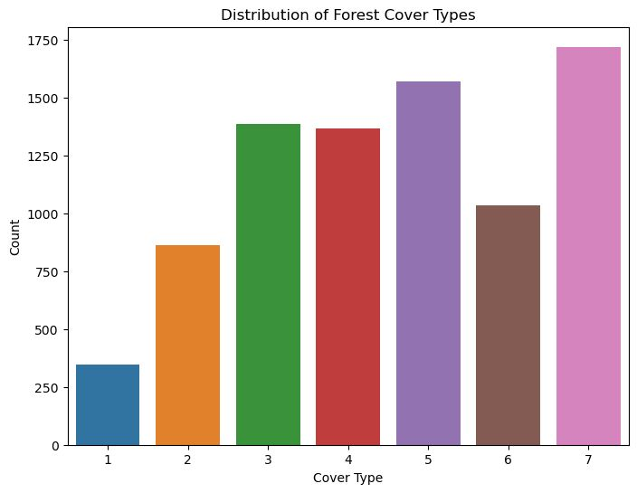
Distribution of forest cover types

Slide 9
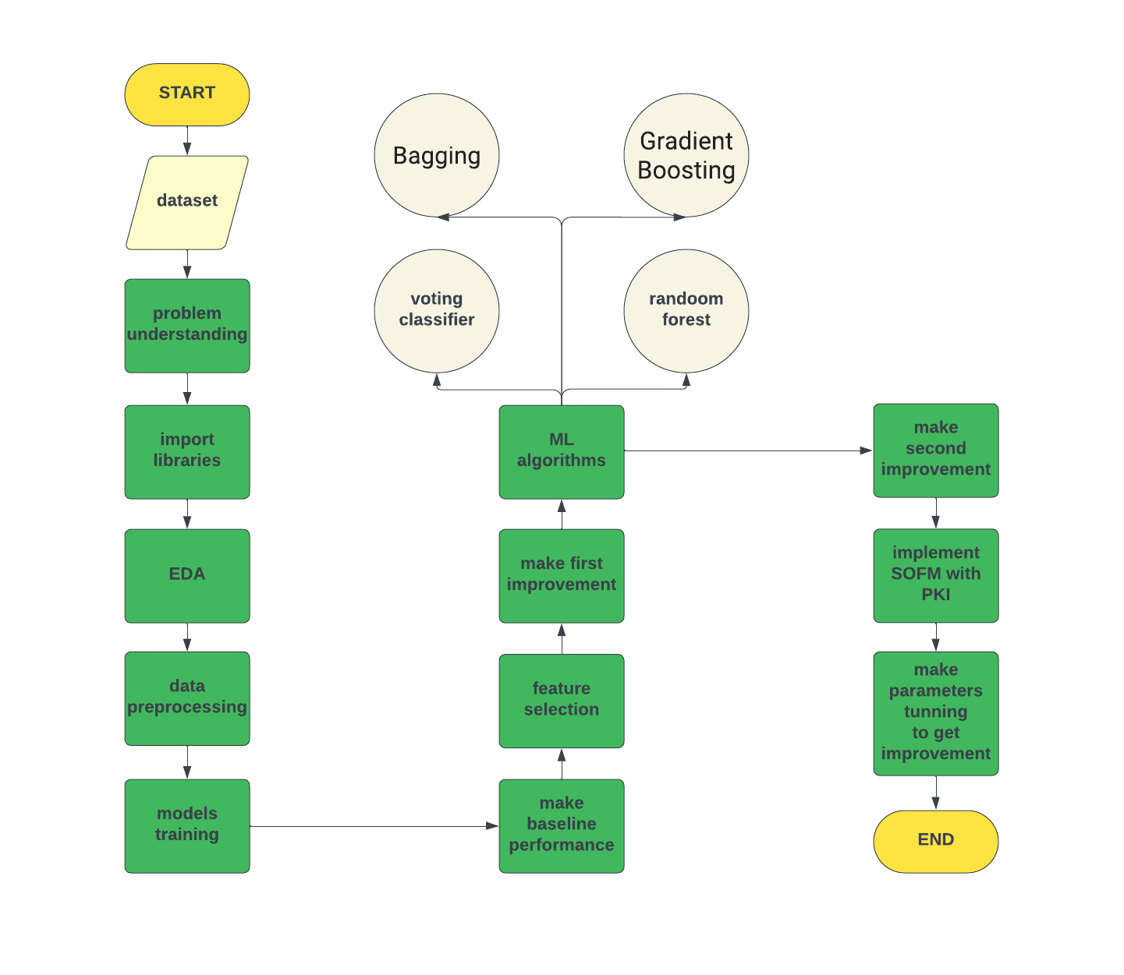
General Flowchart

Slide 10
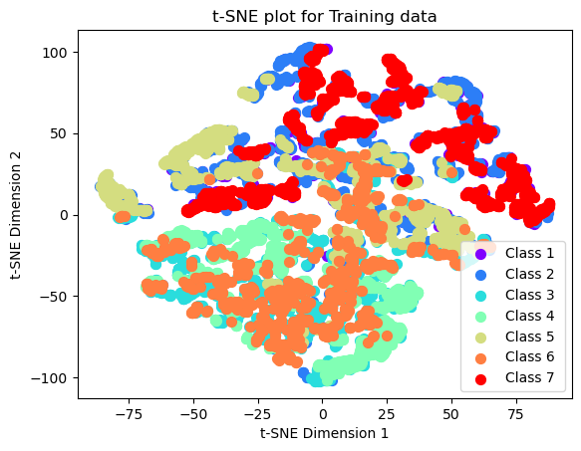
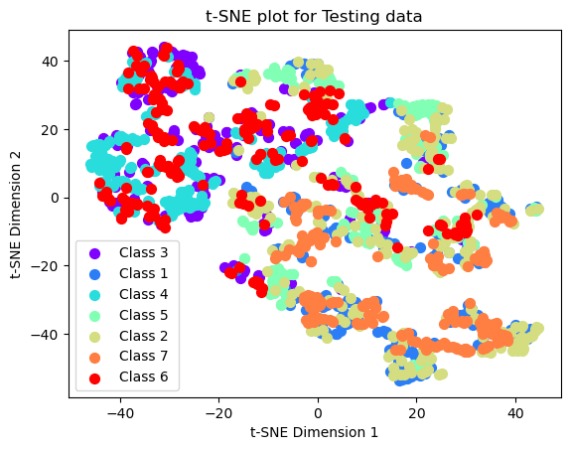
Visualize the training and test set

Slide 11
ML Methods

Slide 12
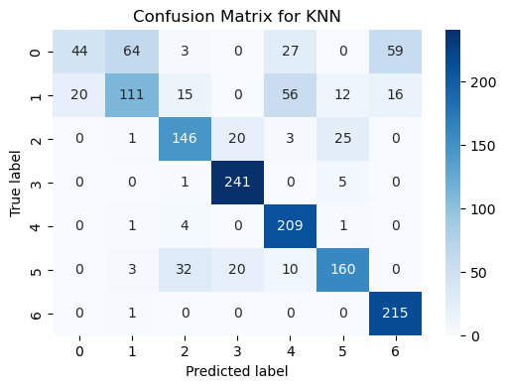
KNN
KNN Accuracy: 73.8360655737705

Slide 13
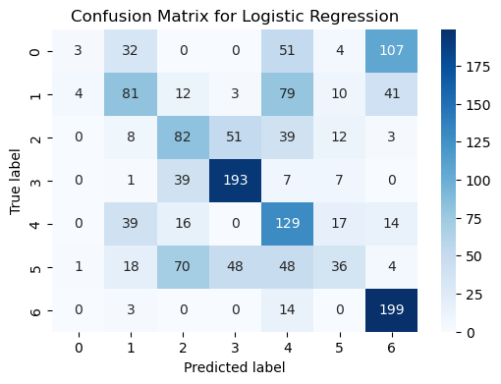
Logistic Regression
Logistic Regression Accuracy : 47.40983606557377

Slide 14
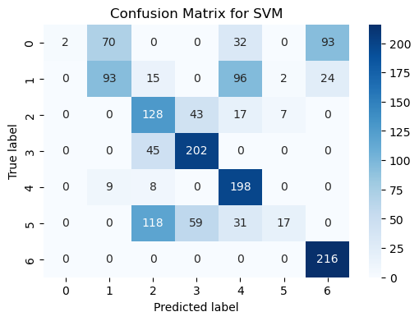
SVM
SVM Accuracy: 56.131147540983605

Slide 15
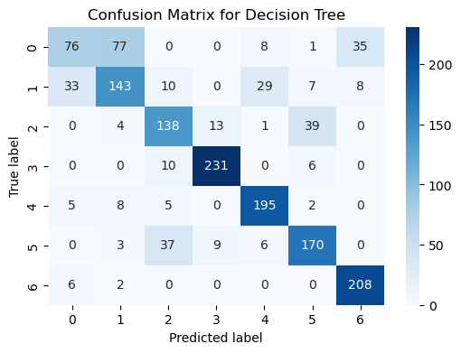
Decision Tree Classifier
Decision Tree Accuracy: 76.1311475409836

Slide 16
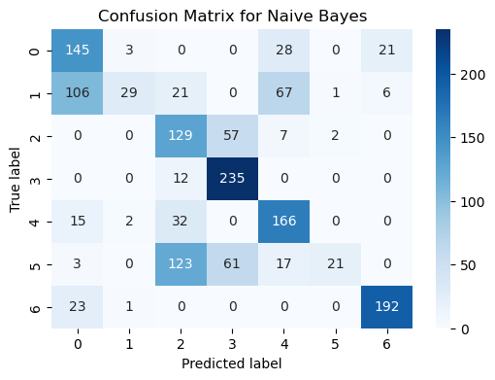
Naive Bayes Classifier
Naive Bayes Accuracy: 60.13114754098361

Slide 17
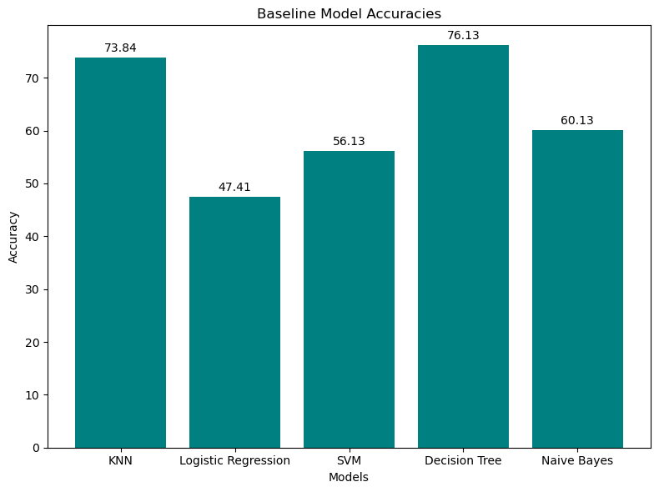
The best baseline performance

Slide 18
Dimensionality Reduction

Slide 19
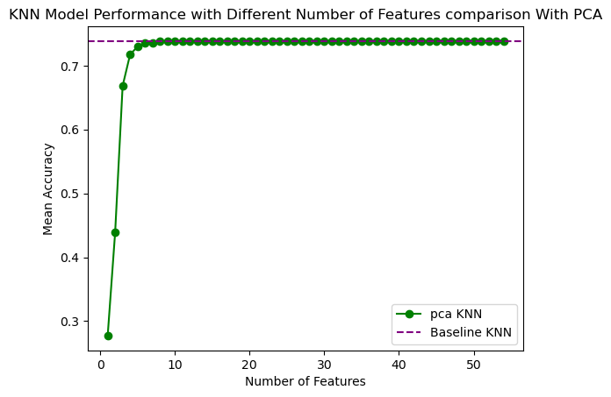
PCA for KNN

Slide 20
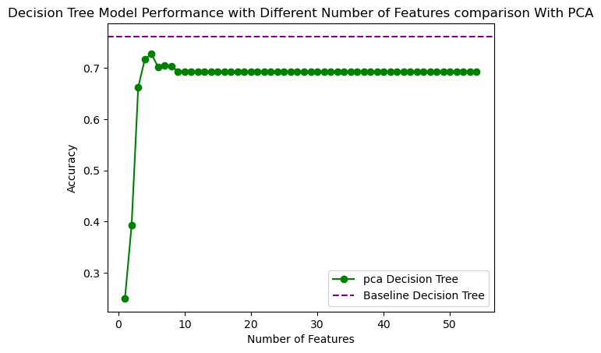
PCA for Decision Tree

Slide 21
feature selection

Slide 22
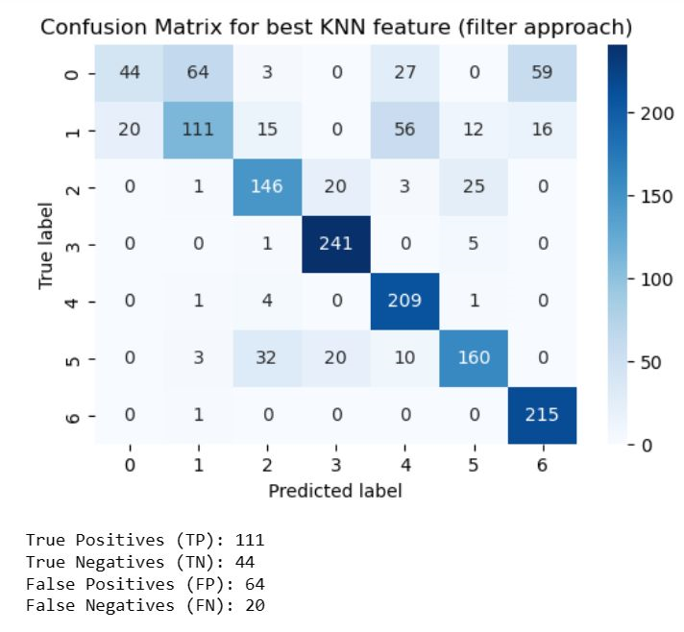
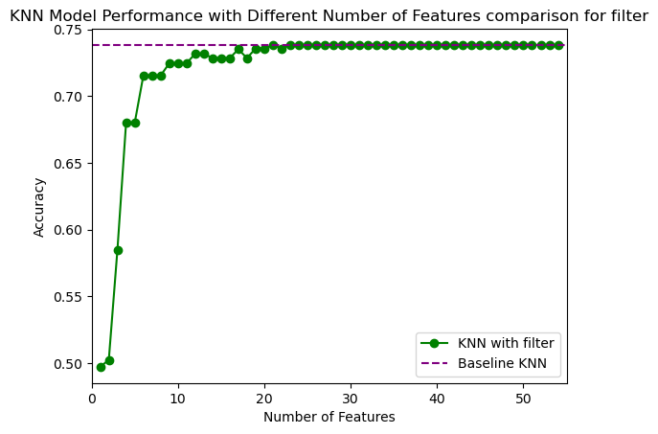
filter approach for KNN

Slide 23
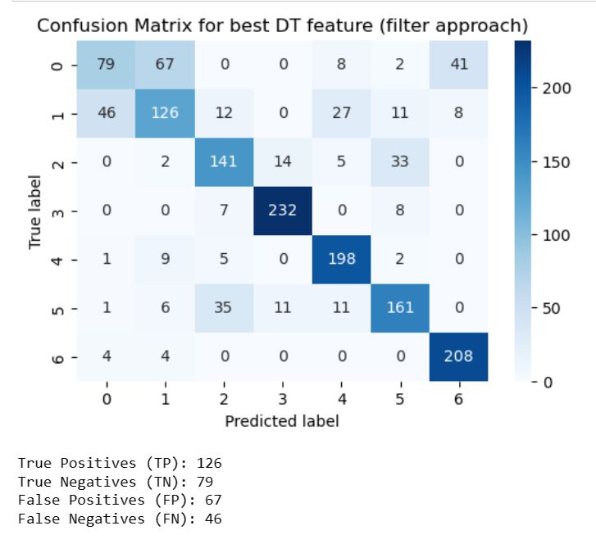
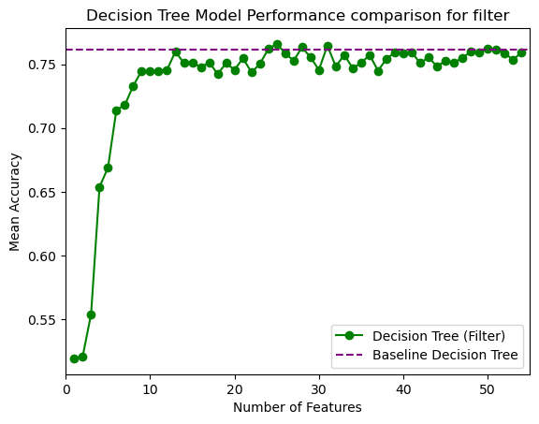
Filter approach for Decision Tree

Slide 24
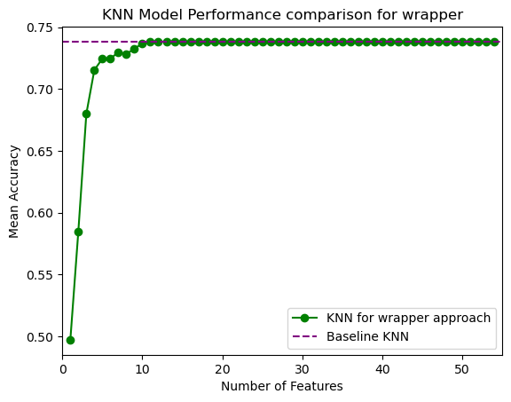
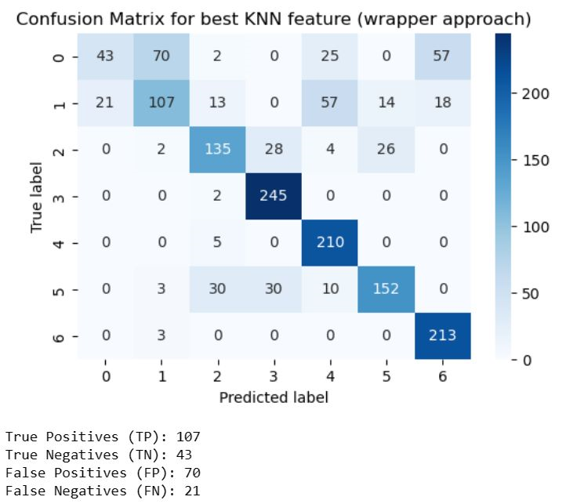
Wrapper aaproach for KNN

Slide 25
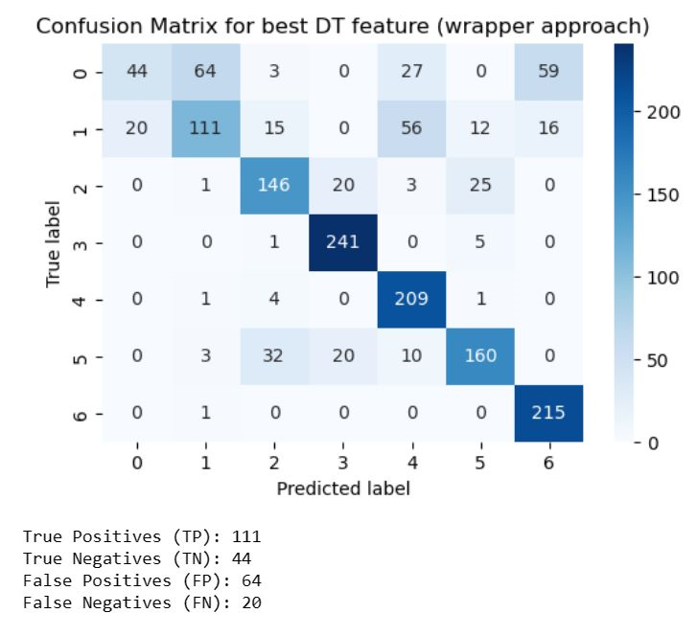
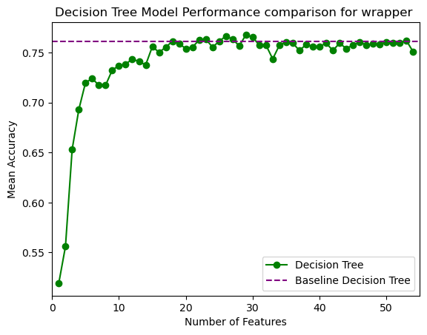
Wrapper approach (RFE) for Decision Tree

Slide 26
Other ML Model

Slide 27
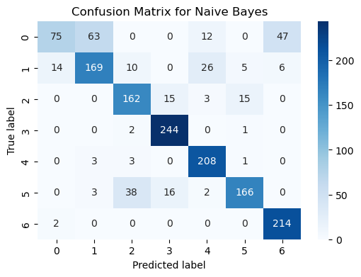
Random Forest
Random Forest Accuracy: 0.8118032786885246

Slide 28
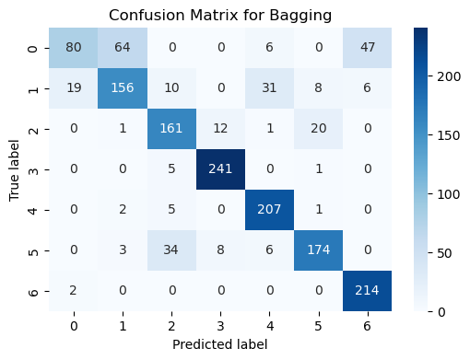
Bagging
Bagging Accuracy: 0.8085245901639344

Slide 29
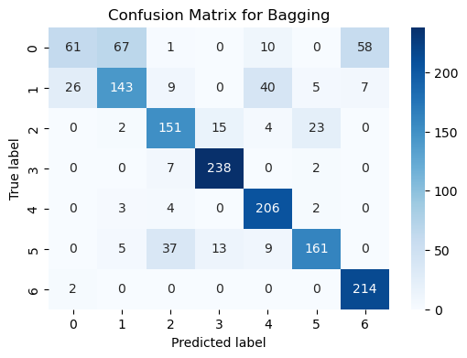
Voting
Voting Classifier Accuracy: 0.77

Slide 30
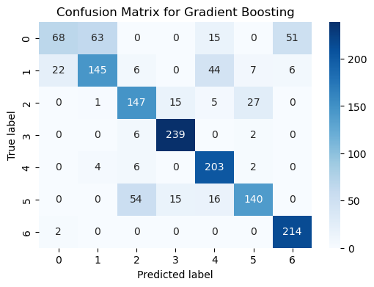
Gradient Boosting
Gradient Boosting: 0.7580327868852459

Slide 31
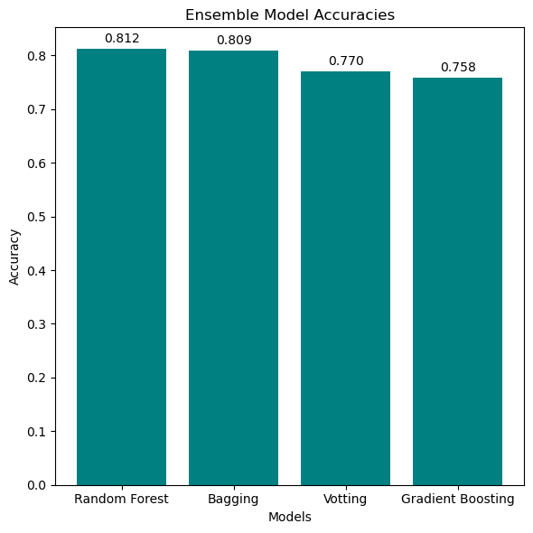
Plotting the results of ensemble models

Slide 32
Supervised & Unsupervised Combination via PKI

Slide 33
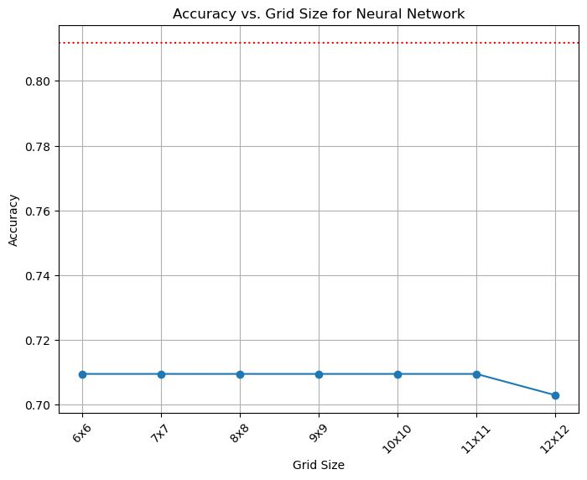
SOFM

Slide 34
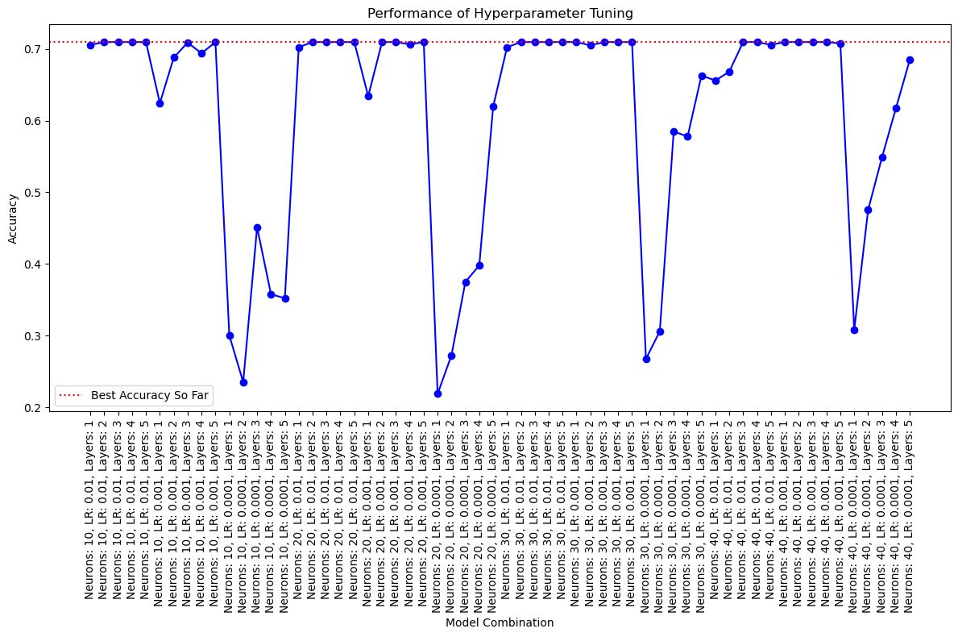

Slide 35
Conclusion
First Improvement : Decision Tree(filter method)
Second Improvement : Random Forest
Third Improvement : PKI achieve very good accuracy

Slide 36
THANK YOU

